Slide 1

Team Leadership

Slide 2
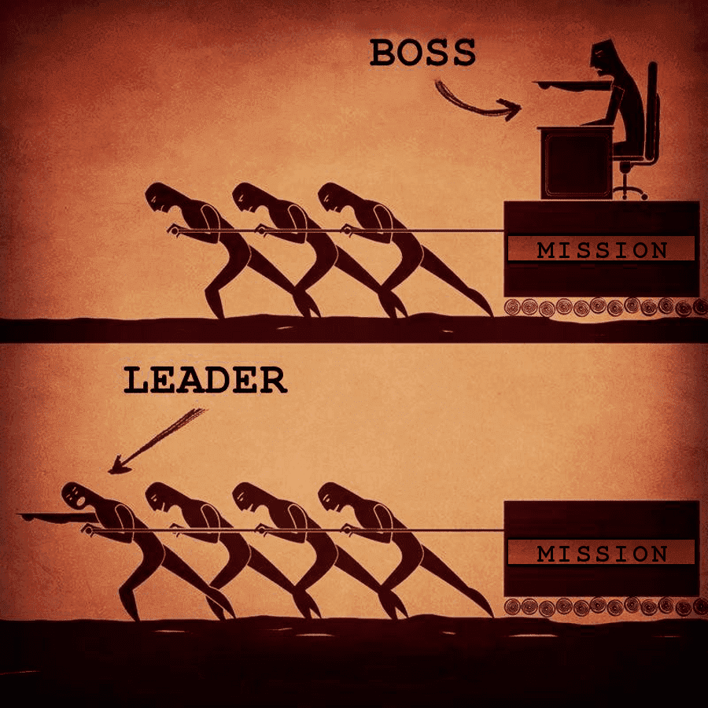
Being/Becoming a Leader
Leaders don’t need titles
If you have the title, you’re expected to be a leader.
Align with the team mission and goals
Tone setter (not always most talented)
Lead by example
Don’t overstep
Ask for help
Help identify and create other leaders
Read “Good to Great” and other leadership books

Slide 3

Where are the followers?
You can’t lead yourself – who are you leading?
Followers follow when they
  Respect the leader
  Trust the leader
  Are appreciated for their work
  Know they are contributing to the goal
Vocalize publicly!

Slide 4

Leaders Find Future Leaders
Everyone has a combination role of leader/follower in different amounts.
Pay attention to those who others gravitate to and give them positive tasks to complete with a team.
Be careful to spread the love and not to rely too much on the same one or two people in this role.

Slide 5

Integrity
Integrity in leadership means consistently acting with honesty, ethical principles, and accountability, aligning actions with words and upholding values, even when faced with challenges.
Integrity is what you do when no one is watching.
Having integrity will not always make you popular and will often make you a target.

Slide 6

Team Dynamics
No hazing. No bullying. No othering.
This is a family and sometimes fills a role better than the family you’re born into.
The success of your new people equals the success of your team.
Address issues when they are small
Vegas – to a point
Personality Tests - True Colors Test at usacheer.org/ihscco

